Slide 1
Internet Censorship and Online Speech Chapter 2: Protocol Censorship
Nick Feamster University of Chicago

Slide 2
Forms of Internet Protocol Interference
Internet Protocol (IP) / Transmission Control Protocol (TCP) Blocking
Domain Name System (DNS) Blocking and Manipulation
Border Gateway Protocol (BGP) Hijacking
Web (HTTP) Block Pages / Redirection
Throttling

Slide 3
Internet Censorship and Online Speech Chapter 2.1: TCP/IP
Nick Feamster University of Chicago

Slide 4
IPv4 Addresses
Topological Addressing
32-bit number in “dotted-quad” notation
www.cs.uchicago.edu --- 128.135.164.125
128
135
164
125
10000000
10000111
10001100
01111101
Network (16 bits)
Host (16 bits)
Problem: 2³² addresses is a lot of table entries
Solution: Routing based on network and host
130.135.0.0/16 is a 16-bit prefix with 2¹⁶ IP addresses

Slide 5

TCP/IP: Background
SYN [IP ID:X]
SYN/ACK [IP ID: Y]
ACK [IP ID:X+1]
Notes:
First some backgrounds:
Remember the TCP uses a three way handshake. Though You might not remember that each packet has IPID field, a 16 bits that is used for fragmentation reasons. I will use this field later.
Following tcp protocol states if I send an unsolicited SA to a host , then it should respond with a RST.
And finally if I send a syn to site with open port, it responds with SA. If I don’t send Ack or RST, because TCP is reliable the site retransmit synack multiple times
These are the properties of network protocol that I plan to leverage in Spooky scan and consequently Auger.

Slide 6
TCP/IP Firewalls
Need a topological “chokepoint”
If the network is a graph, the firewall is a cut in the graph that partitions the graph into two or more disjoint components
Firewalls are often used to protect devices in the presence of a network perimeter where there is an easy way to separate “good” from “bad” devices.
Common firewall software
Snort
iptables
Commercial Software: Blue Coat

Slide 7
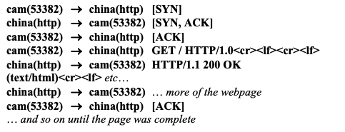
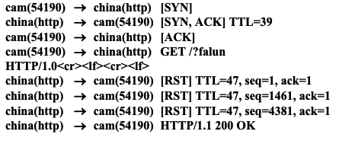
TCP Reset Injection
Normal Web Download
On-path firewall system can detect content that should be censored and inject traffic that resets the TCP connection.
Causes client to abort the connection or report some kind of generic error.
Based on content, between two hosts the firewall wishes to block, …
Can be done in either direction
Initial circumvention was to simply ignore the RST packets!
Connection Reset
Discovered by Clayton et al. (2007)
Notes:
The first three reset packets had sequence values that corresponded to the sequence number at the start of the GET packet; that value plus 1460, and that value plus 4380 (3 × 1460).23 We believe that the firewall sends three different values to try and ensure that the reset is accepted by the sender, even if the sender has already received ACKs for “full-size” (1460 byte) packets from the destination. Setting the sequence value of the reset packet “correctly” is necessary because many implementations of TCP/IP now apply strict checks that the value is within the expected “window.”24 The security vulnerabilities inherent in failing to check for a valid sequence value were first pointed out by Watson in 2004.2

Slide 8
TCP Packet Injection
If an end-host receives two packets with the same sequence number, the operating system will discard the second packet.
Traffic can thus be suppressed by injecting a packet “ahead” of the valid response.

Slide 9
Summary: TCP/IP
TCP/IP is the protocol that most Internet applications rely on for reliable Internet transport.
A common way to interfere with a TCP/IP connection is to simply reset the connection.
Blocking can occur in either direction, or both directions.
Blocking can be based on content (after initial packet exchange), or based on communication endpoints.

Slide 10
Internet Censorship and Online Speech Chapter 2.2: Domain Name System
Nick Feamster University of Chicago

Slide 11
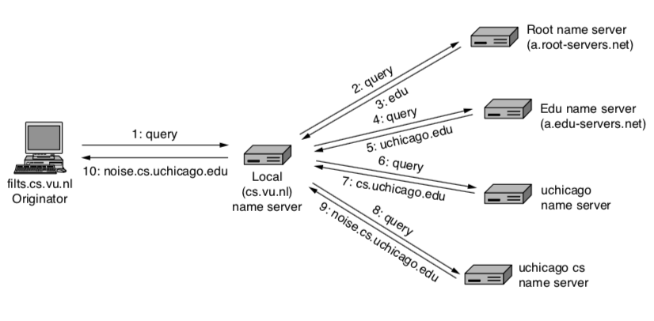
DNS: Mapping Names to Addresses

Slide 12
Using DNS
Local DNS server (“default name server”)
Usually near the end hosts who use it
Local hosts configured with local server (e.g., /etc/resolv.conf) or learn the server via DHCP
Client application
Extract server name (e.g., from the URL)
Do gethostbyname() or getaddrinfo() to get address
Server application
Extract client IP address from socket
Optional gethostbyaddr() to translate into name
12

Slide 13
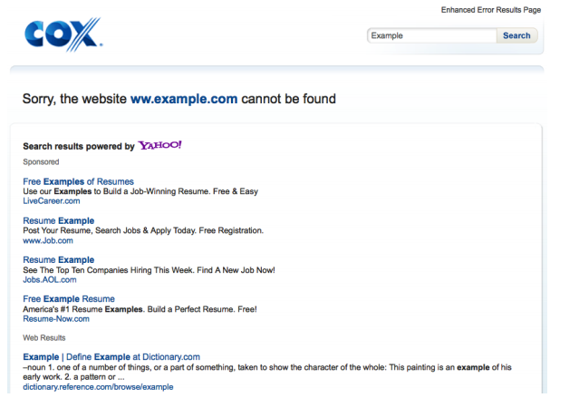
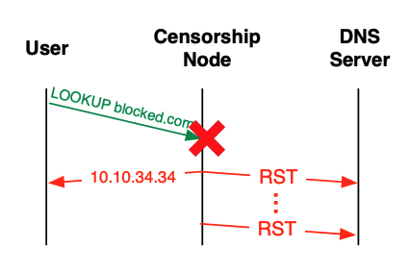
DNS Manipulation: Resolver
Resolver simply returns the wrong answer
Initially used for monetization of DNS errors, “no such domain” responses.
If the censor controls the resolver, it can return any answer to the client. Without DNSSEC, the response is not verified
Observed “on path” in Iran in May 2013.

Slide 14
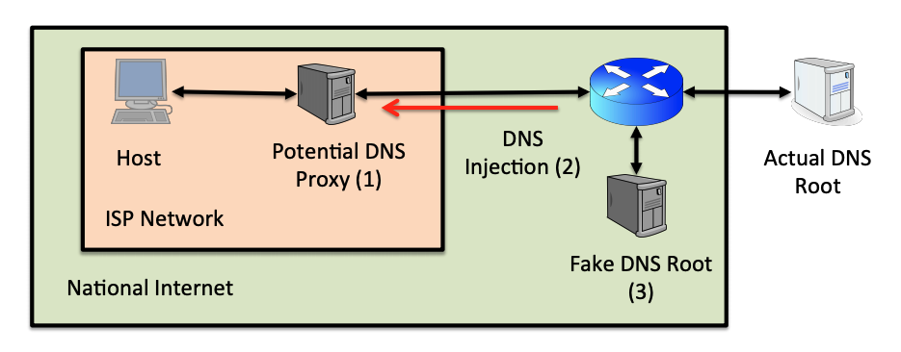
DNS Manipulation: Root Server

Slide 15
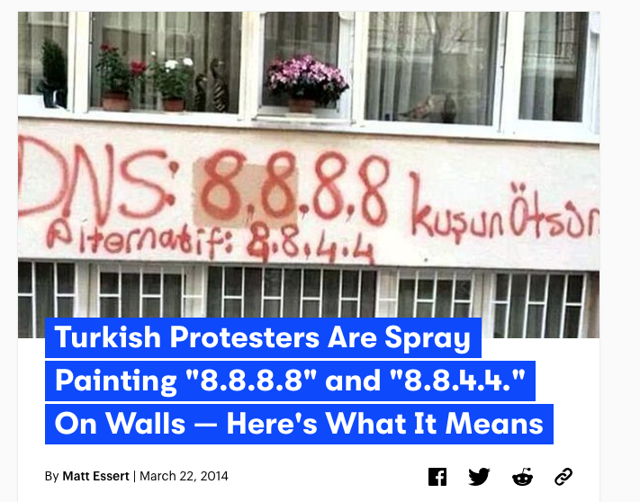
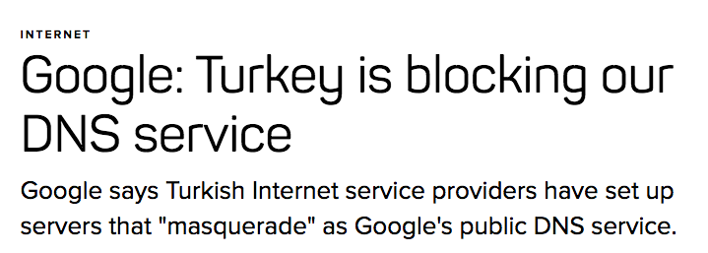

Slide 16
DNSSEC: Signing the DNS REecords
Protects against data spoofing and corruption
Also provides mechanisms to authenticate servers and requests
Provides mechanisms to establish authenticity and integrity of individual responses

Slide 17
DNSSEC: New Resource Records to DNS
Two Public Key-related RRs
RRSIG: signature over RRset made using private key
DNSKEY/DS: public key, needed for verifying a SIG over a RRset, signed by the parent’s private key
One RR for internal consistency (authenticated denial of data)
NXT RR to indicate which RRset is the next one in the zone
Notes:
RFC 2535 discusses these RRs in detail.
CERT RR is outside the scope of this course.

Slide 18
RRSIG
Cover each resource record set with a public-key signature which is stored as a resource record called SIG RR
SIG RRs are computed for every RRset in a zone file and stored
Add the corresponding pre-calculated signature for each RRset in answers to queries
Must include the entire RRset in an answer, otherwise the resolver could not verify the signature

Slide 19
DNSSEC: Verifying the Tree
Question: uchicago.edu
. (root)
uchicago.edu A?
resolver
ask .edu server
SIG (the IP address and PK of .edu server)
by its private key
stub
resolver
uchicago.edu A ?
xxx.xxx.xxx.xxx
.edu
transaction
signatures
add to cache
ask uchicago.edu server
SIG(the IP address and PK of princeton.edu server)
by its private key
SIG(xxx.xxx.xxx.xxx)
by its private key
uchicago.edu
uchicago.edu
Notes:
RRSIG - Contains a cryptographic signature
DNSKEY - Contains a public signing key
DS - Contains the hash of a DNSKEY record
NSEC and NSEC3 - For explicit denial-of-existence of a DNS record
In DNSSEC, each zone has a public/private key pair. The zone's public key is published using DNS, while the zone's private key is kept safe and ideally stored offline. A zone's private key signs individual DNS data in that zone, creating digital signatures that are also published with DNS.
When an end user wants to access a website, a stub resolver on the user's computer requests the website's IP address from a recursive name server. After the server requests this record, it also requests the DNSSEC key associated with the zone. This key allows the server to verify that the IP address record it receives is identical to the record on the authoritative name server.
If the recursive name server determines that the address record has been sent by the authoritative name server and has not been altered in transit, it resolves the domain name and the user can access the site. This process is called validation. If the address record has been modified or is not from the stated source, the recursive name server does not allow the user to reach the fraudulent address. DNSSEC can also prove that a domain name does not exist. As a result of this process, DNS queries and responses are protected from man-in-the-middle (MITM) attacks and the kind of forgeries that could possibly redirect Internet users to phishing and pharming sites.

Slide 20
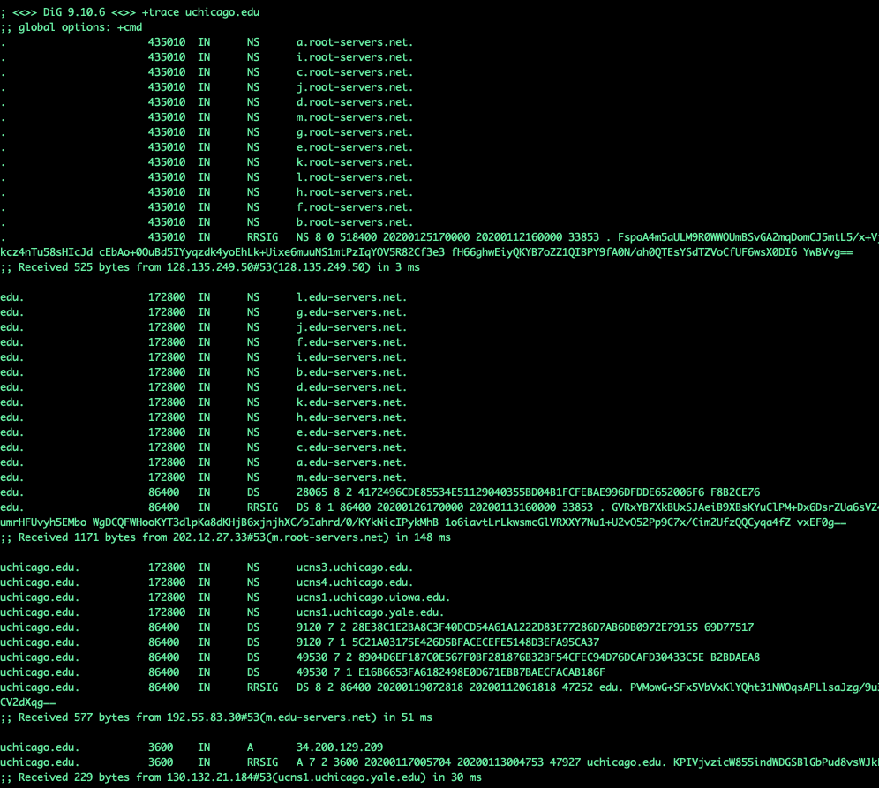

Slide 21
Internet Censorship and Online Speech Chapter 2.3: Border Gateway Protocol
Nick Feamster University of Chicago

Slide 22
Internet Routing Protocol: BGP
Autonomous Systems (ASes)
Route Advertisement
Destination Next-hop AS Path
128.135.0.0/16
Traffic
192.5.89.89
10578..160
128.135.0.0/16
66.250.252.44
174… 160
Session
Notes:
Diagram of routing table is very confusing because it’s not pointing to anything
Green arrow shorter, and too thick… green is a msg
More intuition about how the system actually works.
Don’t say “interdomain”
DESTINATION-BASED Routing
Tables look like a set of possible routes and a rankings over these routes
(pop up a simplified table fragment)

Slide 23
Border Gateway Protocol
Internet’s interdomain routing protocol, BGP, essentially has no security — will believe any routes advertised by neighboring router.
Different ways to interfere with Internet routing:
Cut-off (Egypt case)
BGP “route hijacking”

Slide 24
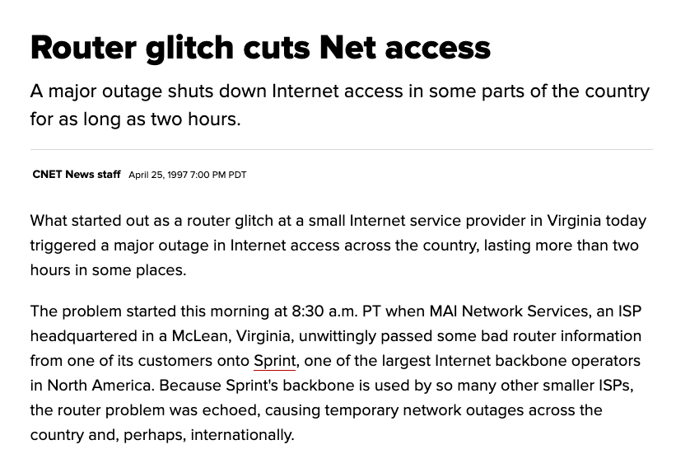

Slide 25
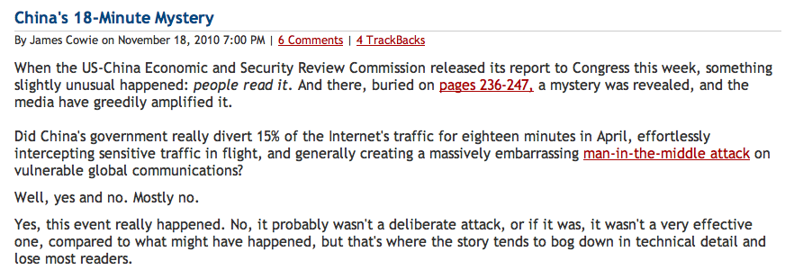
China’s Accidental Hijack

Slide 26
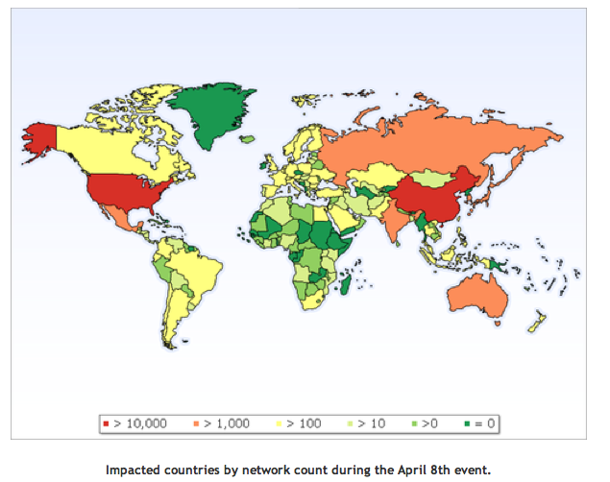
China Hijack: Sequence of Events
On April 8, 2010, China advertised about 50,000 blocks of IP addresses from 170 different countries
60,000 prefixes from the US
Event lasted for 20 minutes
Why did most people not notice?
How might more traffic have been intercepted?
http://www.renesys.com/blog/2010/11/chinas-18-minute-mystery.shtml

Slide 27
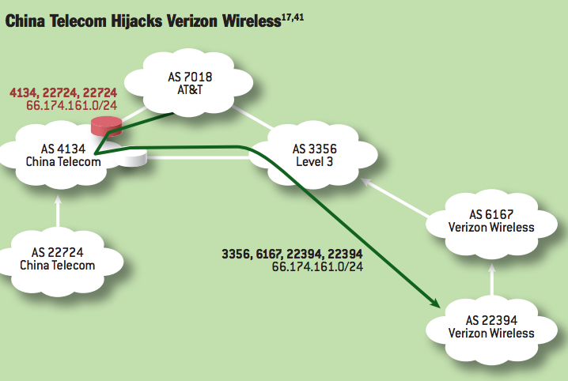
Notes:
China Telecom’s AS 22724 hijacks Verizon Wireless’s prefix 66.174.161.0/24. The bogus route originated by AS 22724 propagates through the AS-level graph and is eventually selected by AT&T because it is shorter than the legitimate route originating at Verizon Wireless’s AS 22394. Meanwhile, Level3 selects the legitimate route, because it is shorter than the bogus route. Thus, network traffic splits between the hijacking AS and the legitimate origin AS, with the nature of the split depending on routing policies used by individual ASes and the topology of the AS-level graph.

Slide 28
Other “Famous” Hijack Events
February 24, 2008: Pakistan advertises a small part of YouTube’s AS 36561
Likely as a botched attempt to block YouTube in Pakistan, following a government order
January 22, 2006: Con Edison (AS 27605) mistakenly advertises lot of networks (Level 3, UUNet, Panix ISP, …)
April 25, 1995: AS 7007 incident
“Ultimately, though, the problem remains on of transitive trust. A provider can and should limit the advertisements it will accept from a customer.”

Slide 29
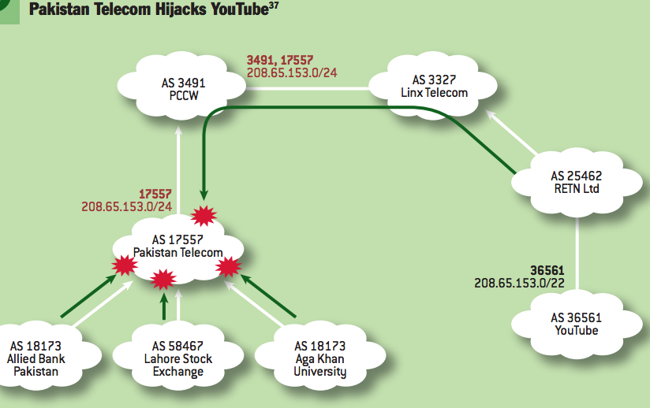
Notes:
Perhaps the most famous subprefix hijack occurred on February 24, 2008, when Pakistan Telecom took YouTube offline. The incident2 began when Pakistani authorities demanded that YouTube to be censored within Pakistan. To accomplish this, Pakistan Telecom’s AS 17557 launched a subprefix hijack by originating the subprefix 208.65.153.0/24 of YouTube’s prefix 208.65.153.0/22 to its customer ASes in Pakistan (e.g., Aga Khan University, Lahore Stock Exchange, Allied Bank Pakistan), as in figure 3.37,41 This meant that traffic destined for YouTube’s servers in AS 36561 would instead be forwarded to the longer IP prefix originated by Pakistan Telecom’s AS 17557, where traffic could then be dropped. Events took an unexpected turn when Pakistan Telecom’s bogus BGP announcement leaked out of Pakistan. PCCW, a large ISP that provides global network connectively to Pakistan Telecom, received the bogus routing announcement, selected the bogus route, and announced it to its own neighbors. Because the bogus route was for a longer prefix (/24) than the legitimate route (/22), longest-prefixmatch routing meant the bogus route was always more preferred by the legitimate route, and within minutes, at least two-thirds of the Internet was sending its YouTube traffic to Pakistan.2

Slide 30
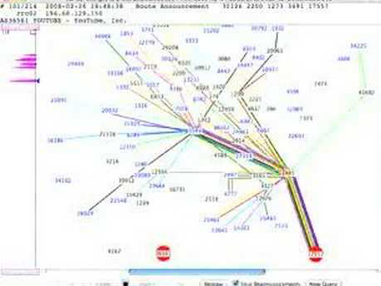

Slide 31
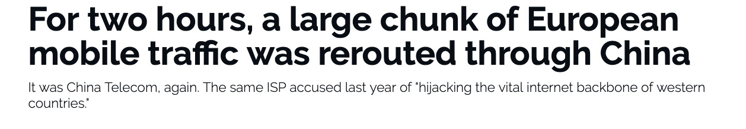
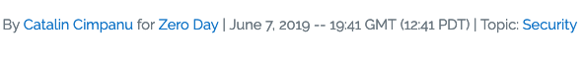
BGP Hijacking Continues…
Notes:
https://www.zdnet.com/article/for-two-hours-a-large-chunk-of-european-mobile-traffic-was-rerouted-through-china/

Slide 32
Internet Censorship and Online Speech Chapter 2.4: Web Page Blocking
Nick Feamster University of Chicago

Slide 33
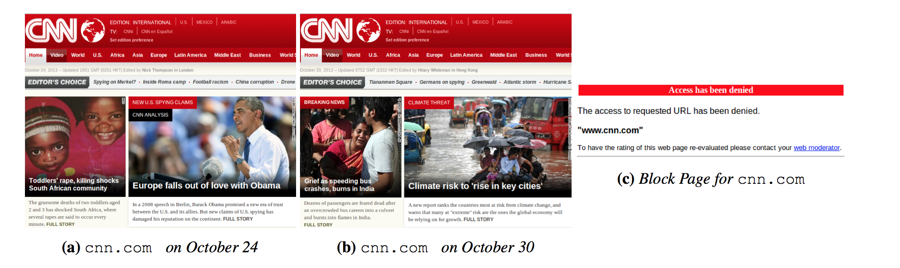
HTTP/Web Filtering: Block Pages
Differences in accessible pages inhibit block page detection
Pages are structurally similar, but contain different content
Lots of possible metrics, but length works well!
Jones et al., “Automated Detection and Fingerprinting of Censorship Block Pages”. ACM Internet Measurement Conference. 2014.

Slide 34
Internet Censorship and Online Speech Chapter 2.5: Throttling And Rate Limiting
Nick Feamster University of Chicago

Slide 35
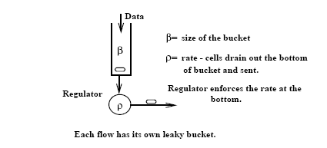
Leaky Bucket Traffic Shaper
Developed by Jon Turner, 1986 (Washington University, St. Louis)

Slide 36
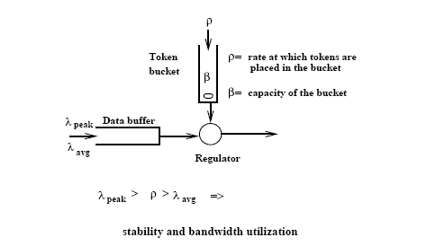
Token Bucket Traffic Shaper

Slide 37
Comparison between TB and LB
Token Bucket | Simple Leaky Bucket
TB permits burstiness, but bounds it | LB forces bursty traffic to smooth out
Burstiness is bounded as follows: - Flow never sends more than β+τ*ρ tokens worth of data in interval τ and - Long-term transmission rate will not exceed ρ | Flow never sends faster than ρ worth of packets per second
TB does not have discard or priority policy | LB has priority policy
TB more flexible | LB is rigid
TB is easy to implement Each flow needs counter to count tokens, each flow needs timer to determine when to add new tokens to the counter | LB is easy to implement

Slide 38
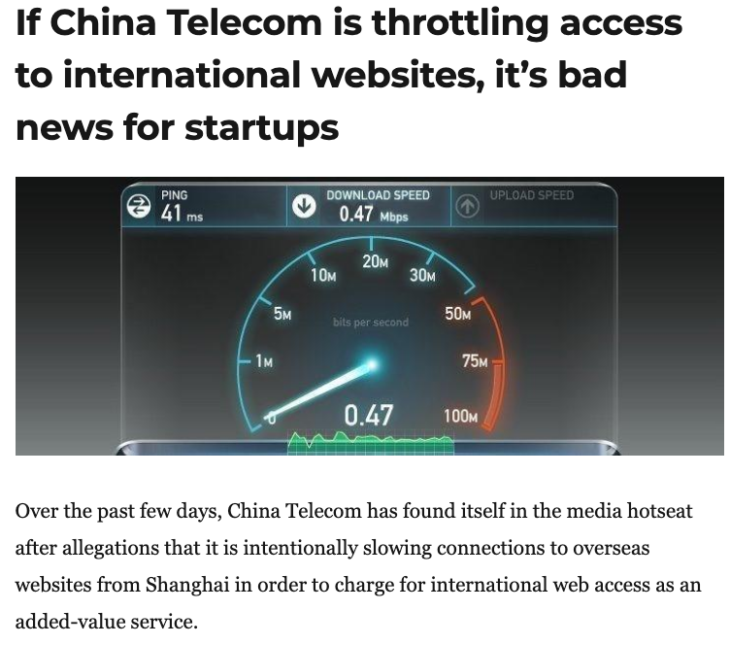
Throttling and Rate Limiting
An example of what Roberts calls “friction”: Increase the cost of accessing a site or service by slowing it down.
Very hard to detect reliably!

Slide 39
Summary: Protocol Censorship
Protocol manipulation: Interferes with communication
TCP/IP: Blocking, packet injection
DNS: Manipulation, redirection, …
BGP: Blocking, hijacking
Throttling/rate limiting: Increases friction for accessing sites and services
Open problems: Detecting different types of manipulation

Slide 40
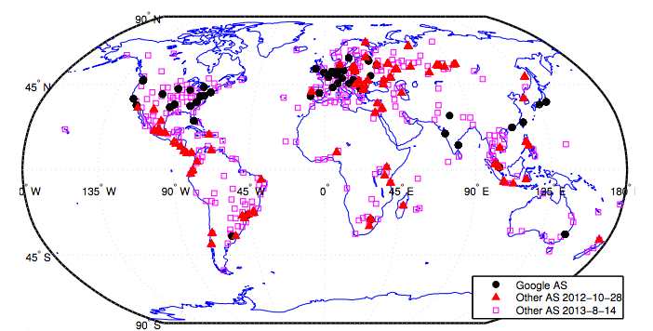
Detecting DNS Manipulation
Strawman: Find instances where the IP address returned does not agree with the “right answer”.
Problem: There is not a single right answer…
Extreme example: IP addresses returned for google.com (Katz-Bassett et al.)
Pearce, Paul, et al. "Global Measurement of DNS Manipulation." 26th {USENIX} Security Symposium ({USENIX} Security 17). USENIX} Association, 2017.

Slide 41
Consistency Metrics
IP Address
Autonomous System (“ISP”)
HTTP Content returned
Consistency of HTTPS certificate
Reverse DNS lookup (IP address to name)

Slide 42
Independently Verifiable Metrics
Content of HTTPS Certificate
Does the IP address present a correct domain in a valid, browser-trusted certificate
Same test, but with certificate fetched with SNI (the domain name)

Slide 43
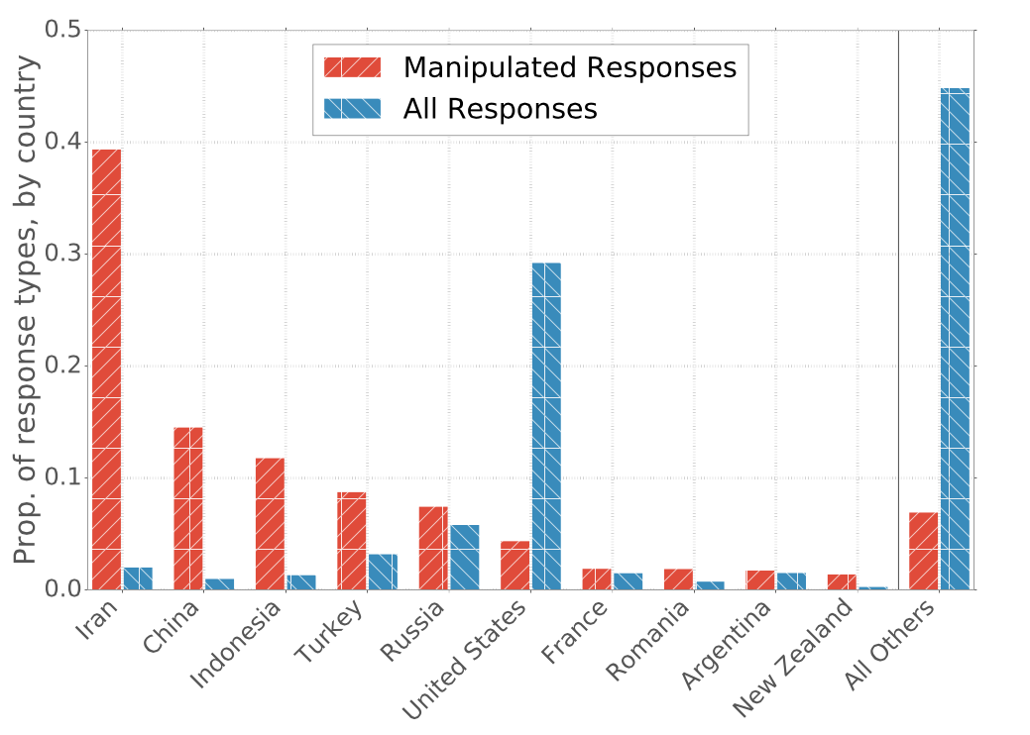
Prevalence of Manipulation by Country

Slide 44
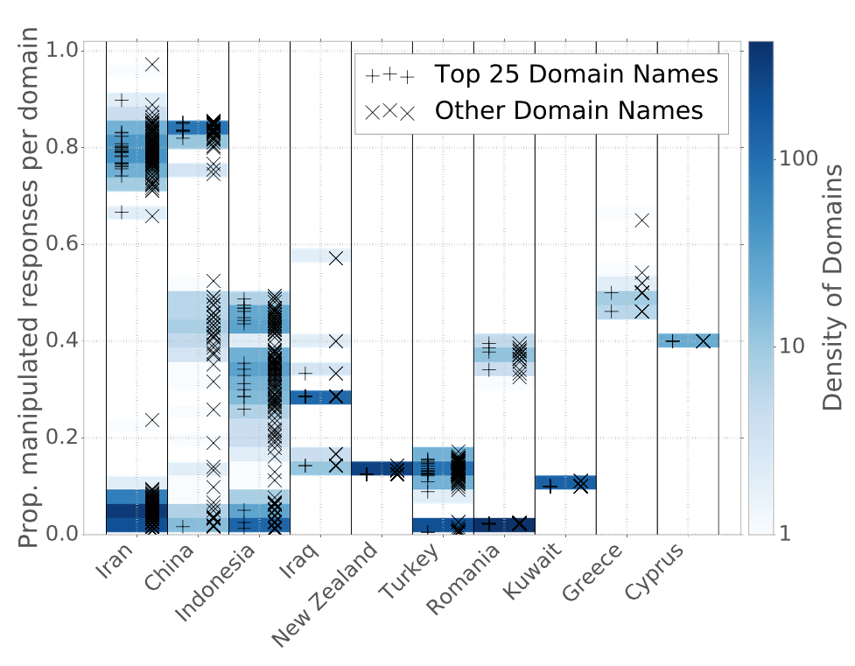
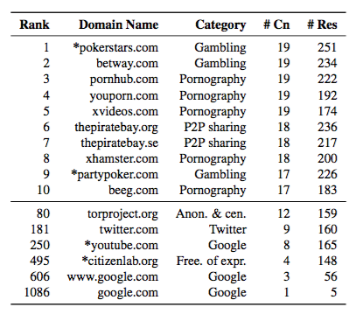
Manipulation of Domains within Countries
Notes:
----- Meeting Notes (4/14/17 13:50) -----
Need a version of this plot by category.

Slide 45
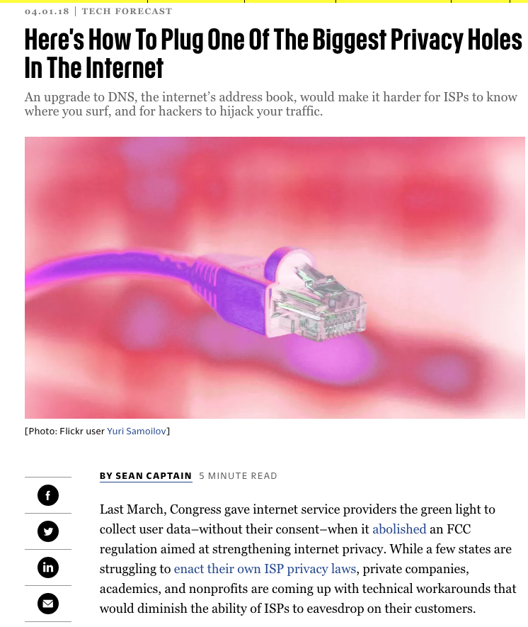

Slide 46
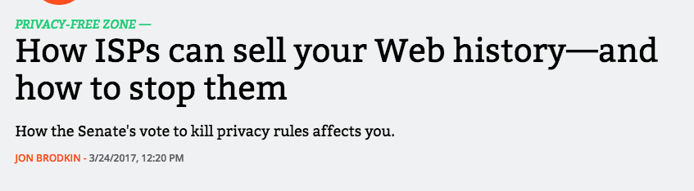
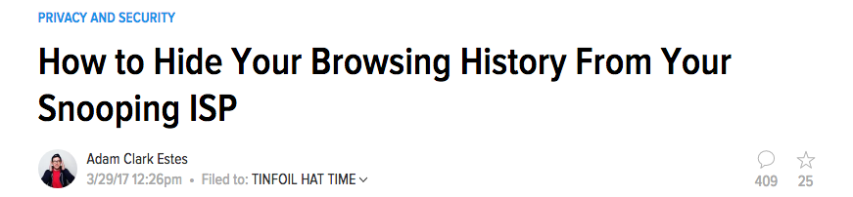
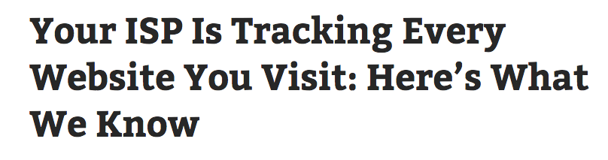
A Discussed Concern...

Slide 47


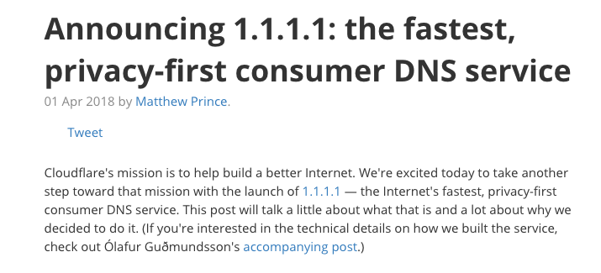
Strawman: Change DNS Providers

Slide 48
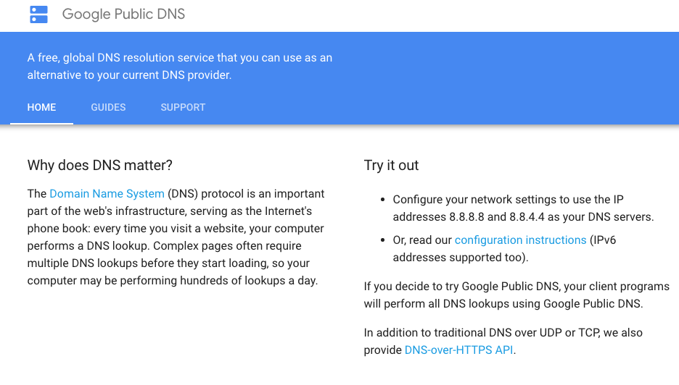

Slide 49
Problem Solved?
No. Just shifted the point of trust from your ISP/default DNS operator to some other party
IP address and DNS domain name still visible and coupled (even with T-DNS, DNSSEC, etc.)
All of the original threats (privacy, censorship, etc.) still remain
Incentives may be different but the technical flaws remain

Slide 50
Oblivious DNS
Key insight: Decouple the DNS query (and response) from the IP address that issued the query
Obfuscate the DNS query before sending it to the local recursive resolver
Generate a referral to an ODNS authoritative server that can decipher the query
ODNS authoritative can see the query, but not the IP address that issued the query*

Slide 51
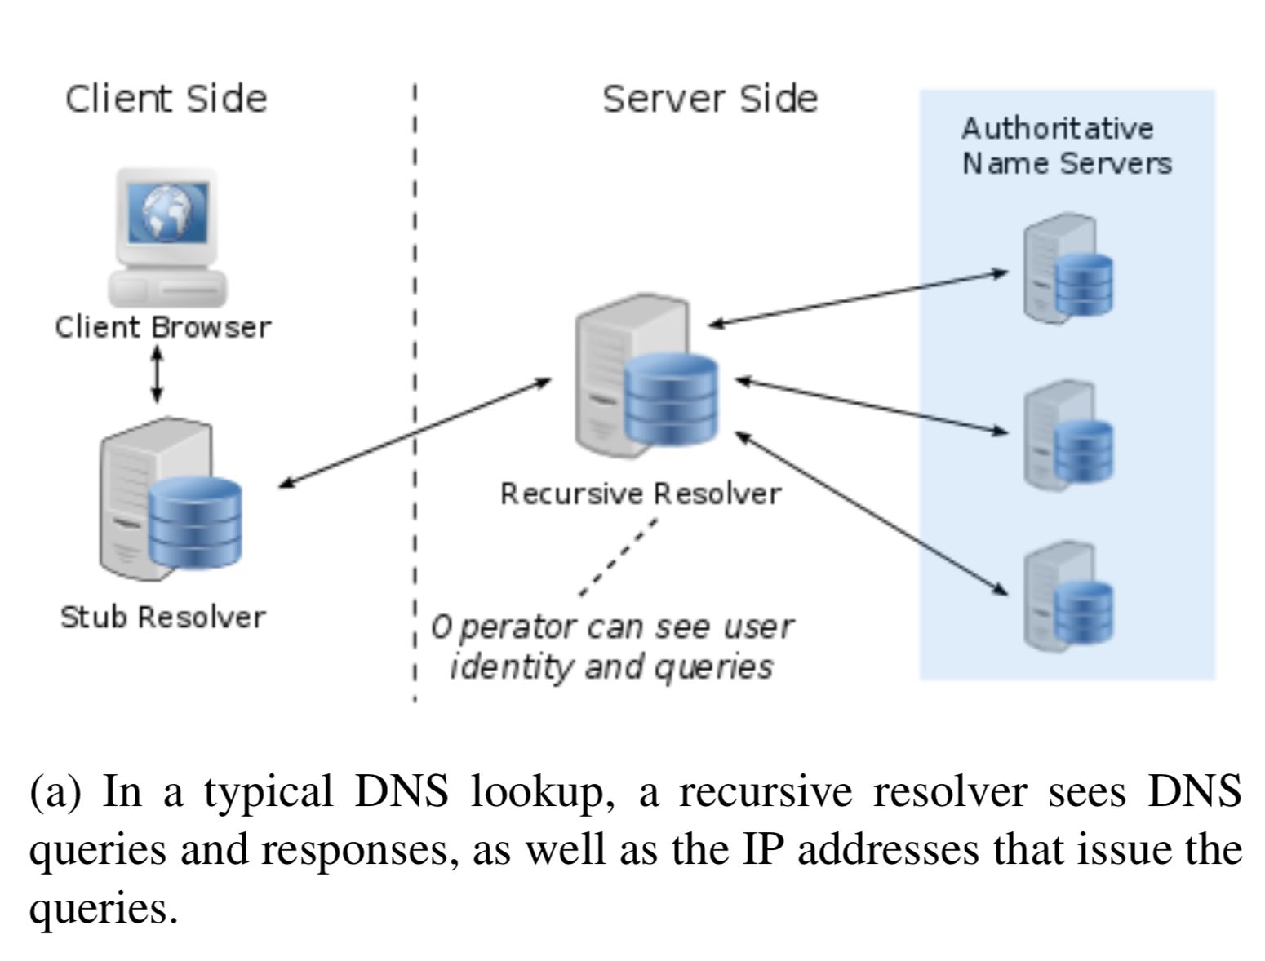
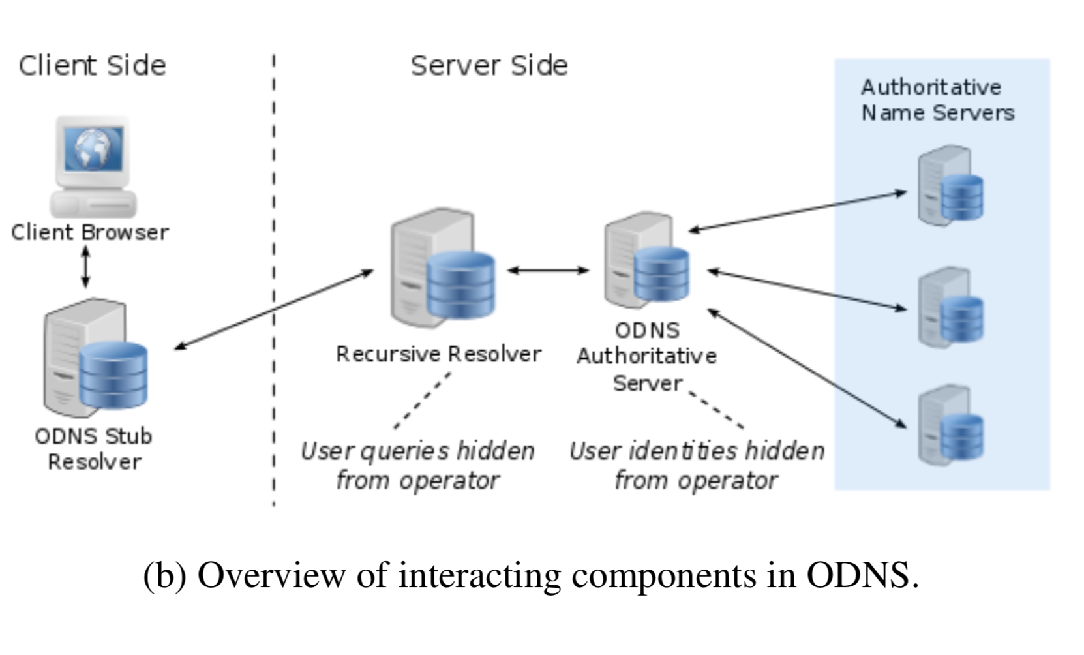
Conventional DNS
Oblivious DNS (ODNS)

Slide 52
Detection of Censored Content
IP-based: Filter based on destination IP address
Note: May be challenging in some circumstances, such as cloud-hosted services
DNS-based: Filter based on domain name
Note: May become more complicated as DNS traffic becomes encrypted
Deep Packet Inspection (DPI)-based: Perform more sophisticated attempts to filter based on contents of packet
Web fingerprinting
…

